Slide 1
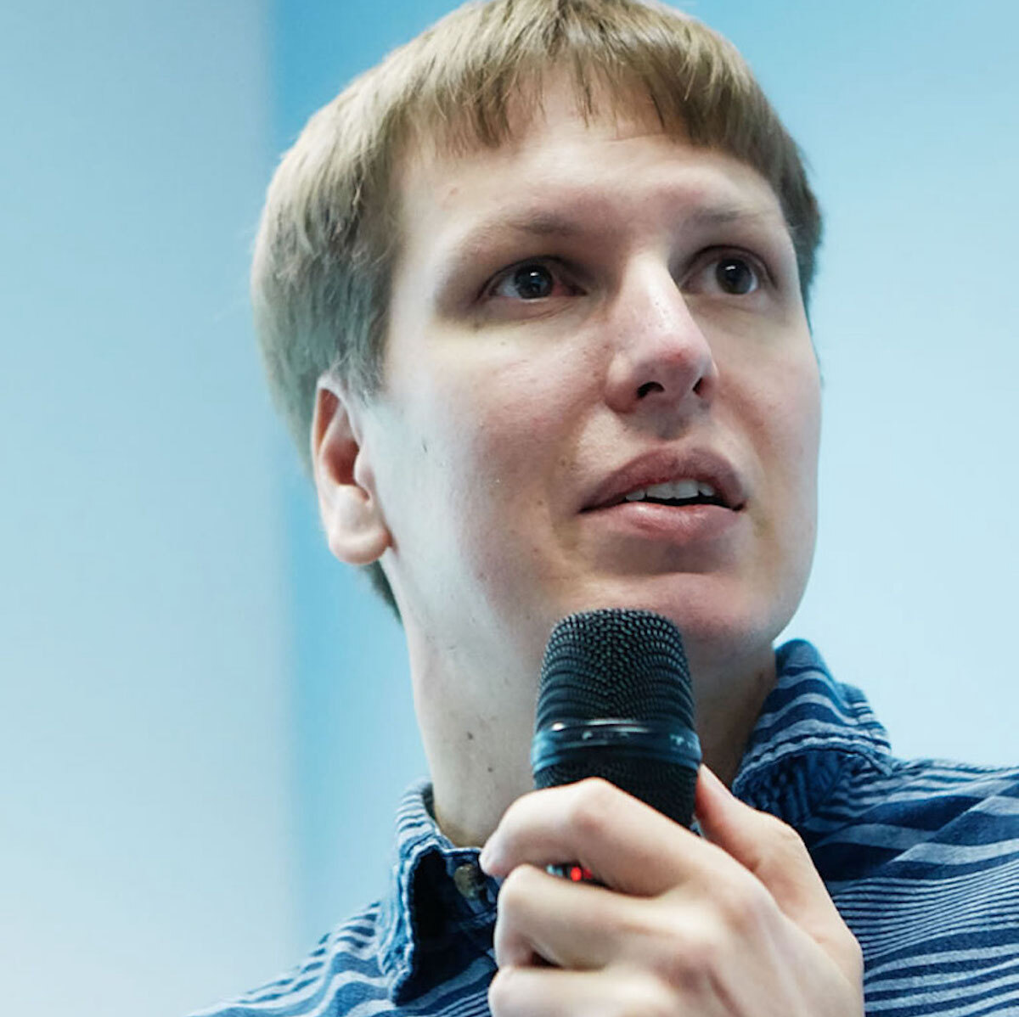
Making a Career out of Open Source
Peter Zaitsev,
Founder at Percona
24 October 2023

Slide 2
Who are you ?
Open Source Software Founders ?
Open Source Software Contributors ?
Aspiring to be ones ?

Slide 3
Premise of this talk
You Love Open Source
You want to make a living doing what you love

Slide 4
What is your Passion ?
Open Source in general
Certain “space”
Certain Open Source Project

Slide 5
Basic Choices
Freelance
Get a Job
Start a Company

Slide 6
Picking “space” and a Core Project
Hot project in hot space generates a lot of opportunities
They may, or may not last

Slide 7
Bet on a Winner
“Winner Takes it All”
May be more than one, but small number of Technologies

Slide 8
Ecosystem
Core Project Creates “ecosystem”
Opportunity for many smaller projects to thrive
Think Linux, PostgreSQL, Hadoop, Kubernetes ecosystems

Slide 9
Niche in Thriving Ecosystem
Can be great focus for Independent Developer

Slide 10
Open Source Project vs Product
Any code on Github can be called Open Source Project
Many Projects are focused on their Developer(s)
Developer writes what he feels that
May not care about documentation, compatibility, QA
May not care about user and customer support

Slide 11
Product – Commitment to Users and Customers
Clear Licensing
Lifecycle, Compatibility Promise, Upgrades
Builds/Packages
Documentation
Free or Commercial Support, Bug/Issue Handling
Security Issues Remediation
Quality Assurance

Slide 12
What is your interest ?
Not Every developer interested in the everything it takes to do the product

Slide 13

Looking into the Choices

Slide 14
Freelance – Positives
Easy to get started
Chose what projects to take
Can try part time while having other job
Can start our own project paid by customers
Can develop long term customers and make a good living

Slide 15
Freelance – Negatives
Actually Writing Code may be small part
Finding Customers, Negotiating, Collecting, Admin takes a lot of time
Many small customers – high overhead one large customer – risky
Burnout is common

Slide 16
Take a Job
Company Using Open Source Software
Company releasing Internal Software as OpenSource
Company Building Open Source Software Product

Slide 17
Company Using Open Source Software
Widest Choice of Companies
May be able to contribute some code to Open Source Projects
Contribution Policies vastly different between companies
Ask on the interview if it is important for you
Some companies may restrict contribution even in your free time
Contribute to the projects with Bugs Reports, Documentation etc

Slide 18






Company Releasing Internal Open Source

Slide 19
Company Releasing Internal Open Source
Contribute Code to Open Source Project
Often Focus is Internal Customers
Community Participation and Personal Brand Development
Start the Company based on such product in the future

Slide 20
Company Building Open Source Product
Focus on building Open Source or somewhat Open Source Software
Customer Focus in the Product

Slide 21
Company Stage
Early Stage
Be at the Project Roots
More Influence
More Risk
Variety of Roles
Growth Potential
Equity
Later Stage
Stability
Clear Processes
Less Influence
More Corporate

Slide 22
Start Your Own Company
Not just Engineering Skills needed!
Are you Entrepreneur ?
Do you have Business Minded Co-Founder ?
Marketing and Selling is a hard job which Engineers often do not appreciate

Slide 23
Do you need to be Project Founder ?
It helps a lot but it is not a requirement
RedisLabs great example of company which was NOT started by Redis founder

Slide 24
Basic Choices
Services Company
Product Company

Slide 25
Services Company
Can grow out of individual freelancing
Can be relatively easy to bootstrap
Easy to maintain Independence/Complete Control
Low Margin Quite Competitive Business
Can be great Lifestyle company but unlikely $1B “exit”

Slide 26
Product Company
Build Product around Open Source Project
Funding (Often Venture Capital) is typically required
Products are often only partially Open Source
If Successful Very large exits are possible

Slide 27
Current Company Market Capitalization
Elastic - $7.9B
Couchbase - $0.7B
MongoDB - $24.8B
Gitlab - $6.9B
RedHat sold to IBM for $34B

Slide 28
Whatever Path you Chose
Invest in Building Personal Brand

Slide 29
Some Ideas
Produce Content
Blog ? Podcast ? YouTube Channel
Participate In Community
IRC/Slack Channels, Forums, Conferences
Write a Book
Even self published book looks really good
Write Some Code
Maintain Great GitHub Profile
Get Social
Develop Offline Network, Twitter Following, LinkedIn Connections

Slide 30
Thank you, Let’s Connect!
https://www.linkedin.com/in/peterzaitsev/
https://twitter.com/PeterZaitsev
http://www.peterzaitsev.com

